Slide 1
Get started with data engineering on Azure
Notes:
Before delivering this presentation, review the associated modules on Microsoft Learn (https://aka.ms/mslearn-data-engineer) and complete the exercise.

Slide 2

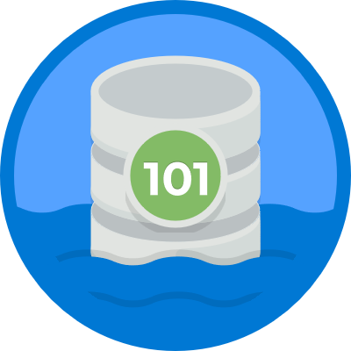

Agenda
Introduction to data engineering on Azure
Introduction to Azure Data Lake Storage Gen2
Introduction to Azure Synapse Analytics

Slide 3
Introduction to data engineering on Azure

Slide 4



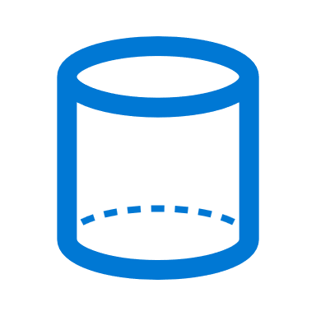



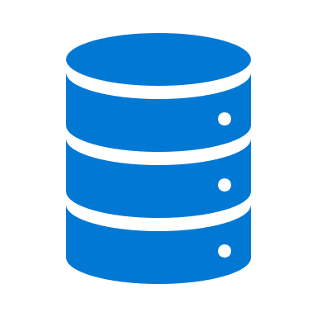

What is data engineering?
Data engineers work with multiple types of data to perform a variety of data operations using a range of tools and scripting languages
Types of data
Data operations
Languages
Structured
SQL
Integration
SELECT…
{
…
}
Semi-structured
Transformation
Python
df=spark.read(…)
Unstructured
Consolidation
R
Java
Others
Scala
.NET
Notes:
Use the slide contents from left to right to discuss the role of a data engineer:
Data engineers work with a range of data types (structured, semi-structured, and unstructured)
They perform operations on that data, including integrating systems to connect to multiple data sources, applying transformations to change data structure and format, and consolidating data from multiple sources into a centralized analytical solution.
To do this, they must be proficient with a range of tools and scripting languages – in particular, SQL and Python, and potentially others.

Slide 5









Important data engineering concepts
Operational and analytical data
Streaming data
Data pipeline
Perpetual, real-time data feeds
Orchestrated activities to transfer and transform data.
Used to implement extract, transform, and load (ETL) or extract, load, and transform (ELT) operations.
Operational: Transactional data used by applications
Analytical: Optimized for analysis and reporting
Data Lake
Data Warehouse
Apache Spark
Analytical data stored in files
Distributed storage for massive scalability
Analytical data stored in a relational database
Typically modeled as a star schema to optimize summary analysis
Open-source engine for distributed data processing
Notes:
No two data estates are the same, but the slide describes some common concepts with which data engineers should be familiar.
We’ll be exploring implementation solutions for each of these concepts throughout the course, so make sure students have a solid grasp of them now, ready to build on in later presentations and exercises.

Slide 6


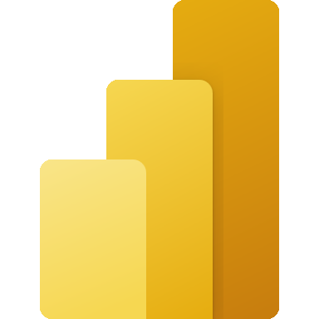


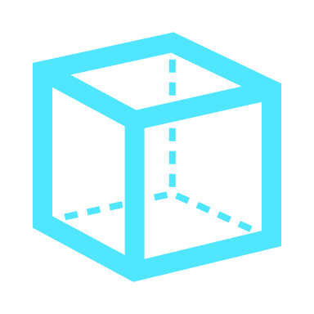






Data engineering in Azure
Operational data
Data ingestion / ETL
Analytical data storage and processing
Data modeling and visualization
Azure Synapse Analytics
Microsoft Power BI
Azure Data Lake Storage Gen2
Azure Stream Analytics
Azure Data Factory
Azure Databricks
Notes:
The slide is complex, so take some time to help students orientate themselves.
The diagram describes the flow from left to right of a typical enterprise data analytics solution. Operational data is generated by applications and devices and must be captured, ingested, and consolidated into analytical stores; from where it can be modeled and visualized in reports and dashboards.
The core technologies covered in this course are in the Data ingestion and Analytical data storage and processing sections – we’ll be exploring these technologies and using them to implement typical workloads in the presentations and exercises that follow.
Although we’ll briefly touch on Power BI in this course, enterprise-level data modeling and visualization is covered in more depth in course DP-500: Designing and Implementing Enterprise-Scale Analytics Solutions Using Microsoft Azure and Microsoft Power BI.

Slide 7

Knowledge check
Data in a relational database table is…
Structured
Semi-structured
Unstructured
In a data lake, data is stored in…
Relational tables
Files
A single JSON document
Which of the following Azure services provides capabilities for running data pipelines AND managing analytical data in a data lake or relational data warehouse?
Azure Stream Analytics
Azure Synapse Analytics
Azure Databricks
Notes:
Allow students a few minutes to think about the questions, and then use the animated slide to reveal the correct answers.

Slide 8
Introduction to Azure Data Lake Storage Gen2

Slide 9


Understand Azure Data Lake Storage Gen2
Distributed cloud storage for data lakes
HDFS-compatibility - common file system for Hadoop, Spark, and others
Flexible security through folder and file level permissions
Built on Azure Storage:
High performance and scalability
Data redundancy through built-in replication
Notes:
The icons at the top of the diagram on the slide represent Azure Synapse Analytics, Azure HDInsight, and Azure Databricks – all there of which include Open Source “Big Data” processing technologies - and in particular Apache Spark. The HDFS file system (and other compatible variants) is fundamental to the distributed data processing techniques used in these, and similar, platforms.

Slide 10


Azure Data Lake Storage Gen 2 vs Azure Blob Storage
Enable Hierarchical Namespace in a blob container to use Azure Data Lake Storage Gen2
Azure Blob Storage
Azure Data Lake Storage Gen2
Azure Storage Account
Azure Storage Account
Blob Container
Blob Container
blob1
Directory
folder1/blob2
File1
File2
Hierarchical Namespace
Blobs can be organized in virtual directories, but each path is considered a single blob in a flat namespace – folder level operations are not supported
File system includes directories and files, and is compatible with large scale data analytics systems like Hadoop, Databricks, and Azure Synapse Analytics
Notes:
It’s important to call out that Azure Data Lake Storage Gen2 is not a separate service from Azure Storage – it’s a capability that can be enabled using the Hierarchical Namespace configuration option for a blob container. The previous version of Azure Data Lake Storage was a separate service, but the capabilities have been enhanced and integrated into Azure Storage to provide a simpler solution that builds on the global scalability already inherent in Azure Storage.
Note that although the inclusion of slashes” in blob names when using a “standard” blob container gives the appearance of a hierarchical “folder-based” storage solution, it’s really just a convenient way to organize blobs in a namespace – you can’t manage the folders as objects independently of the blobs they contain. With the hierarchical namespace enabled, you can perform folder-level operations, such as setting access permissions.

Slide 11
Knowledge check
Azure Data Lake Storage Gen2 stores data in…
A document database hosted in Azure Cosmos DB
An HDFS-compatible file system hosted in Azure Storage
A relational data warehouse hosted in Azure Synapse Analytics
What option must you enable to use Azure Data Lake Storage Gen2?
Global replication
Data encryption
Hierarchical namespace
Notes:
Allow students a few minutes to think about the questions, and then use the animated slide to reveal the correct answers.

Slide 12
Introduction to Azure Synapse Analytics

Slide 13
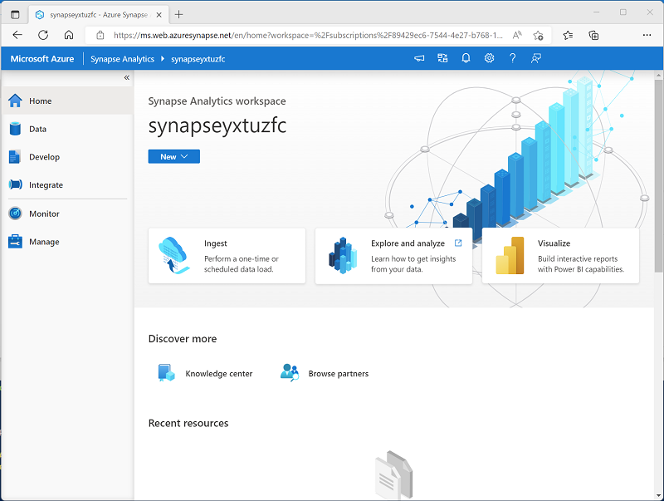
What is Azure Synapse Analytics?
Cloud platform for data analytics
Large-scale data warehousing
Advanced analytics
Data exploration and discovery
Real time analytics
Data integration
Integrated analytics
Notes:
Azure Synapse Analytics is an Azure service that combines multiple data integration, processing, and analytical capabilities. The core Azure resource is a workspace, but the overall service ca include multiple other Azure resources depending on the capabilities you use. For example, an Azure Storage account resource is created to support a data lake for the workspace, A SQL, Spark, or Data Explorer pool resource is created to provide the compute services for data processing, and other resources may be created to support the overall solution. Data engineers generally don’t need to manage these resources independently, but rather use the Azure Synapse Studio web interface (as shown on the slide) to manage the service as a whole.

Slide 14
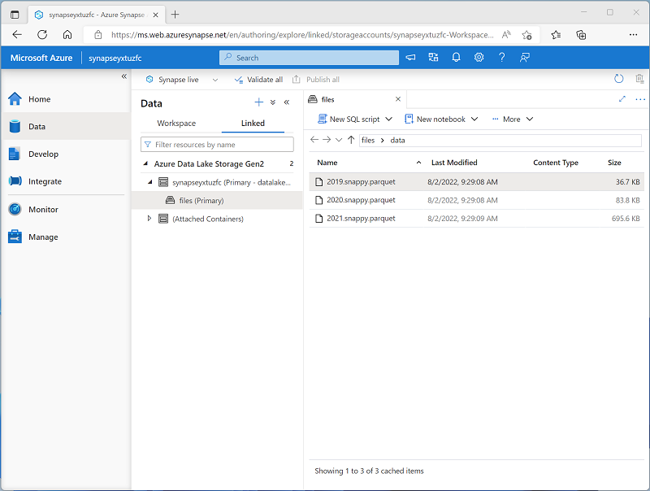
Work with files in a data lake
Connect to data lake storage using linked services
Every Azure Synapse Analytics workspace has a default data lake
Notes:
An Azure Synapse workspace generally has a default (or “primary”) data lake store, implemented as an Azure Data Lake Storage Gen2 container. You can attach multiple data lake sources to the workspace as required. A lot of data engineering tasks involve ingesting data files into the data lake, processing and transforming the files in the data lake, and loading data from data lake files into analytical stores.

Slide 15
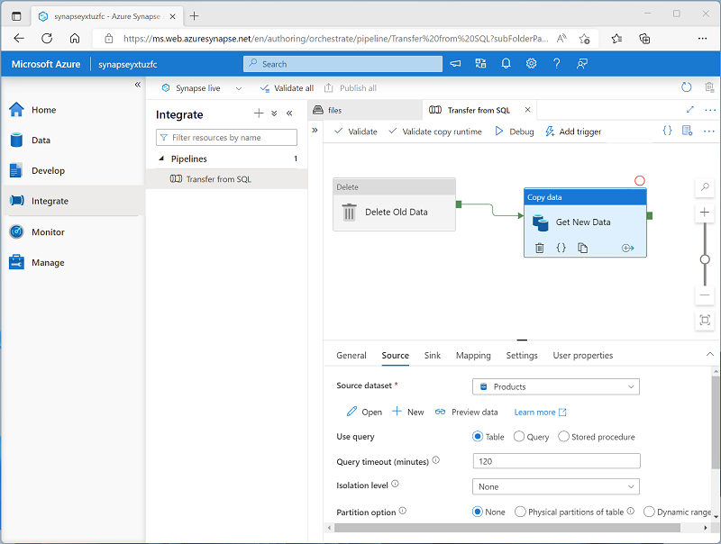
Ingest and transform data with pipelines
Native pipeline functionality built on Azure Data Factory
Orchestrate activities to ingest, transform, and load data
Integrate with other data services
Notes:
If students are already familiar with Azure Data Factory, emphasize that the pipeline functionality in Azure Synapse Analytics is based on the same technology and user experience.
Pipelines are the core integration technology used to implement extract, transform, and load (ETL) or extract, load, and transform (ELT) workloads that bring together data from multiple operational sources into a centralized analytical solution. We’ll explore pipelines in more depth later in the course, so don’t get too deeply into the details here.

Slide 16
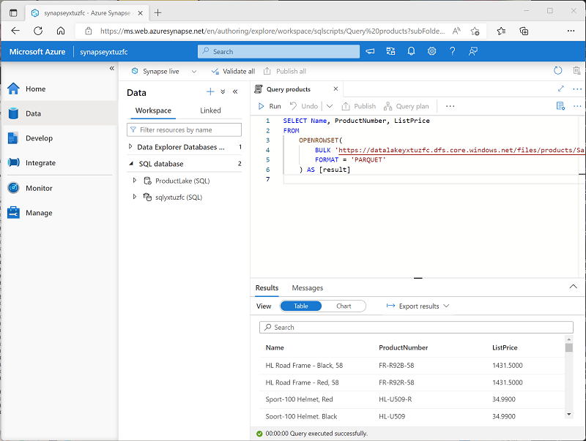
Query and manipulate data with SQL
SQL Server based pools for scalable relational data processing:
Built-in serverless SQL pool for data exploration and analysis of files in the data lake
Custom dedicated SQL pools to host large-scale relational data warehouses
Notes:
SQL is a core skill for any data professional, and man students are likely to already be familiar with SQL language and SQL Server based databases. The key point to make here is that Azure Synapse Analytics provides two similar, but distinct SQL services; a default “serverless” pool that is used to apply SQL operations to structured data files in the data lake, and the ability to create multiple “dedicated” SQL pools that are essentially instances of what was previously called Azure SQL Data Warehouse, and which are used to implement enterprise-scale “massively parallel processing” (MPP) relational data warehouses.
We’ll be exploring both of these SQL capabilities later in the course, so don’t get too deeply into the details here.

Slide 17
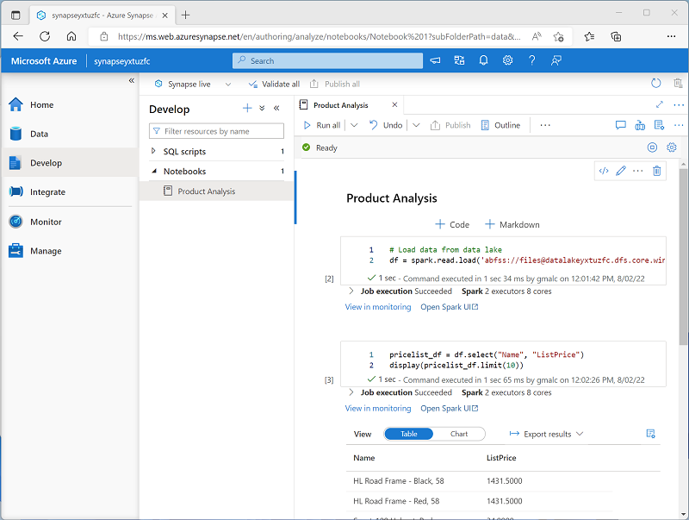
Process and analyze data with Apache Spark
Open-source Spark technology
Highly scalable, distributed processing
Common libraries and multiple programming languages
Integrated notebook experience
Notes:
Apache Spark is an open-source platform that evolved from big data technologies like Hadoop and Hive. It’s designed to provide high scalability by distributing data processing across multiple worker nodes in a cluster, and can process jobs that are written in a variety of programming languages, including Python, Scala, Java, SQL and others. While you can run jobs that are submitted as scripts or compiled executables (such as Java JARs), it’s extremely common for data engineers (and data analysts, data scientists, and other data professionals) to use Spark interactively through notebooks.
Azure Synapse Analytics provides the ability to create one or more Spark pools (dynamically managed clusters) and use integrated notebook functionality in Azure Synapse Studio to run data processing and analysis jobs. We’ll be exploring Spark in Azure Synapse Analytics in greater depth later in the course.

Slide 18
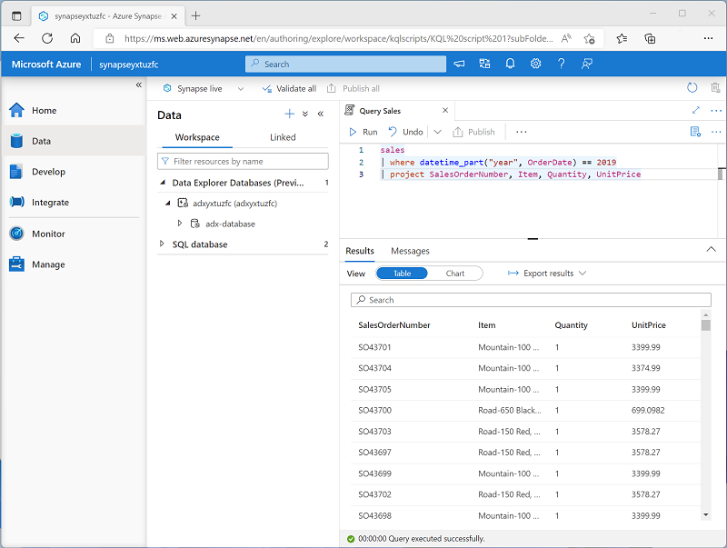
Explore data with Data Explorer
High-performance real-time data analytics
Powerful, intuitive Kusto query language
Notes:
Azure Data Explorer is a standalone Azure service that provides a Kusto data analytics engine. In addition to the standalone service, you can create Data Explorer pools in an Azure Synapse Analytics workspace to integrate Kusto data analytics with the rest of your enterprise data analytics.
Kusto is particularly effective for querying and analyzing streams of real-time data, such as log files or data from Internet of things (IoT) devices.

Slide 19

Exercise: Explore Azure Synapse Analytics
Use the hosted lab environment provided, or view the lab instructions at the link below:
https://aka.ms/mslearn-explore-synapse
Notes:
The exercise will take a minimum of an hour to complete, including 10 minutes or so at the start to set up the environment.
Not all students work at the same pace, so you should allow 90 minutes or more as necessary for your class.

Slide 20
Knowledge check
Which feature of Azure Synapse Analytics enables you to transfer data from one store to another and apply transformations to the data at scheduled intervals?
Serverless SQL pool
Apache Spark pool
Pipelines
You want to create a data warehouse in Azure Synapse Analytics in which the data is stored and queried in a relational data store. What kind of pool should you create?
Serverless SQL pool
Dedicated SQL pool
Apache Spark pool
A data analyst wants to analyze data by using Python code combined with text descriptions of the insights gained from the analysis. What should they use to perform the analysis?
A notebook connected to an Apache Spark pool
A SQL script connected to a serverless SQL pool
A KQL script connected to a Data Explorer pool
Notes:
Allow students a few minutes to think about the questions, and then use the animated slide to reveal the correct answers.

Slide 21

Further reading
Get started with data engineering on Azure
https://aka.ms/mslearn-data-engineer
Notes:
Encourage students to review the online material on Microsoft Learn on which this presentation is based.

